Slide 1
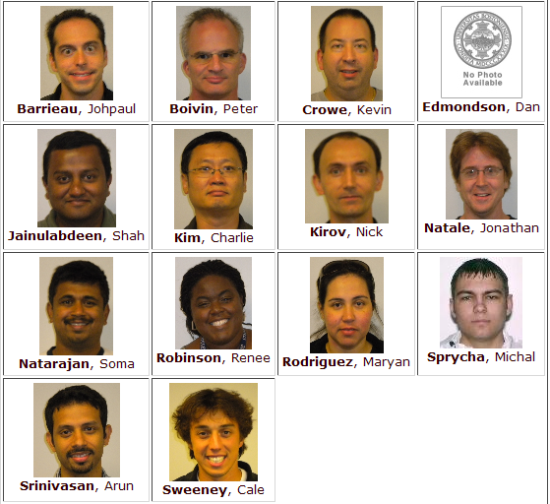
CS 579 Fall 2009 W3

